Slide 1

Using AI in Research: Modes, Use Cases, Ethics, and the Future
John Wallin
Director of the Computational and Data Science PhD Program
Middle Tennessee State University

Slide 2

Codes for the Demo

Slide 3

To run the codes in Google Colab Note: note all the codes are fully implemented in Colab yet.

Slide 4
Options for using AI/ML in research
Basic “ChatBot” interfaces to Large Language Models
API calls to Large Language Models
Machine Learning/Deep Learning Models
Supervised
Unsupervised
Semi-supervised

Slide 5
ChatBots/Large Language Models
Summarizing documents
Answering questions about documents
Generating code or doing basic data analysis
Analyzing or characterizing images
Logic and reasoning?
Reformatting Data

Slide 6
Some quick demos
Summarizing documents – ChatGPT (OpenAI)
1
Querying Documents – NotebookLM (Google)
2
Generating Code – Claude 3.5 (Anthropic)
3
Reformatting Data (OpenAI)
4

Slide 7
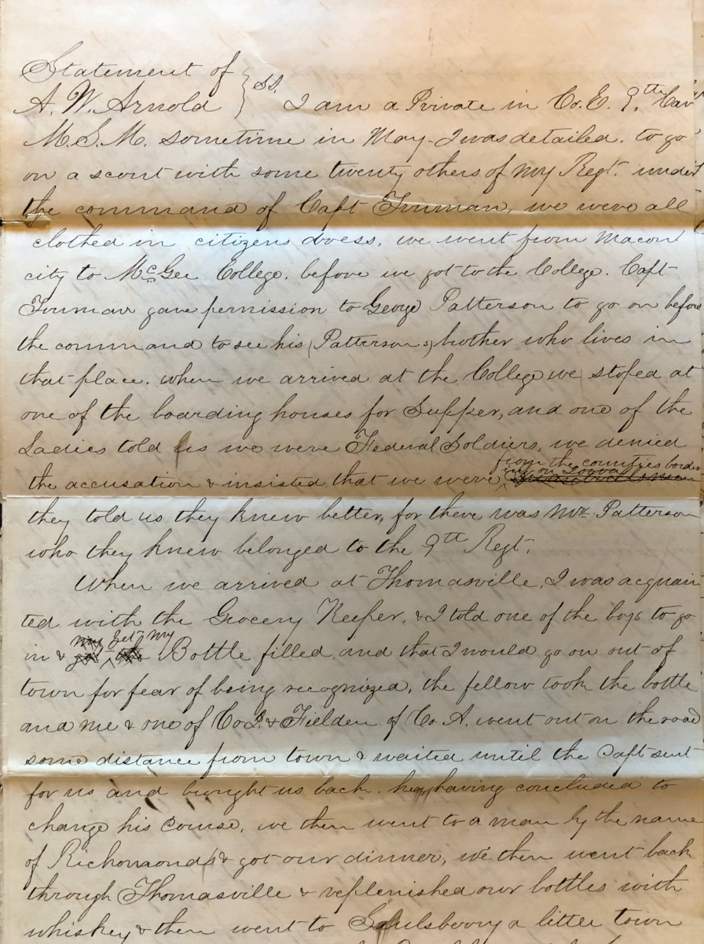
Transcribing handwriting?

Slide 8
Transcription of handwritten letters (ChatGPT)
Chatbot Transcription
Expert Transcription
I am a Private in Co. E. 9th [Tenn?] M.S.M. Sometimes in May, I was detailed to go to [_____?] with some twenty others of my Regt. under the command of Capt. [Furman?]. We were all clothed in citizens dress. We went from Macon city to [Fischer?] College. Before we got to the college, Capt. [Furman?] gave permission to George Patterson to go on before the command and to see his [Patterson?] - whether she lives in that place. When we arrived at the College we stopped at one of the boarding houses for supper, and one of the ladies told us we were [Federal?] soldiers. We denied the accusation & insisted that we were [____] of the country, but they told us they knew better, for there was Mrs. Patterson who they knew belonged to the 9th Regt.
I am a Private in Co. E. 9th Cav
M.S.M. sometime in May, I was detailed to go
on a scout with some twenty others of my Regt. under
the command of Capt Truman, we were all
clothed in citizens dress, we went from Macon
city to McGee College. before we got to the College, Capt
Truman gave permission to George Patterson to go on before
the command to see his (Patterson’s) brother who lives in
that place. when we arrived at the College we stoped at
one of the boarding houses for Supper, and one of the
Ladies told us we were Federal Soldiers, we denied
the accusation & insisted that we were ^ from the counties bordering on Iowa.
they told us they knew better, for there was Mr. Patterson
who they knew belonged to the 9th Regt.

Slide 9
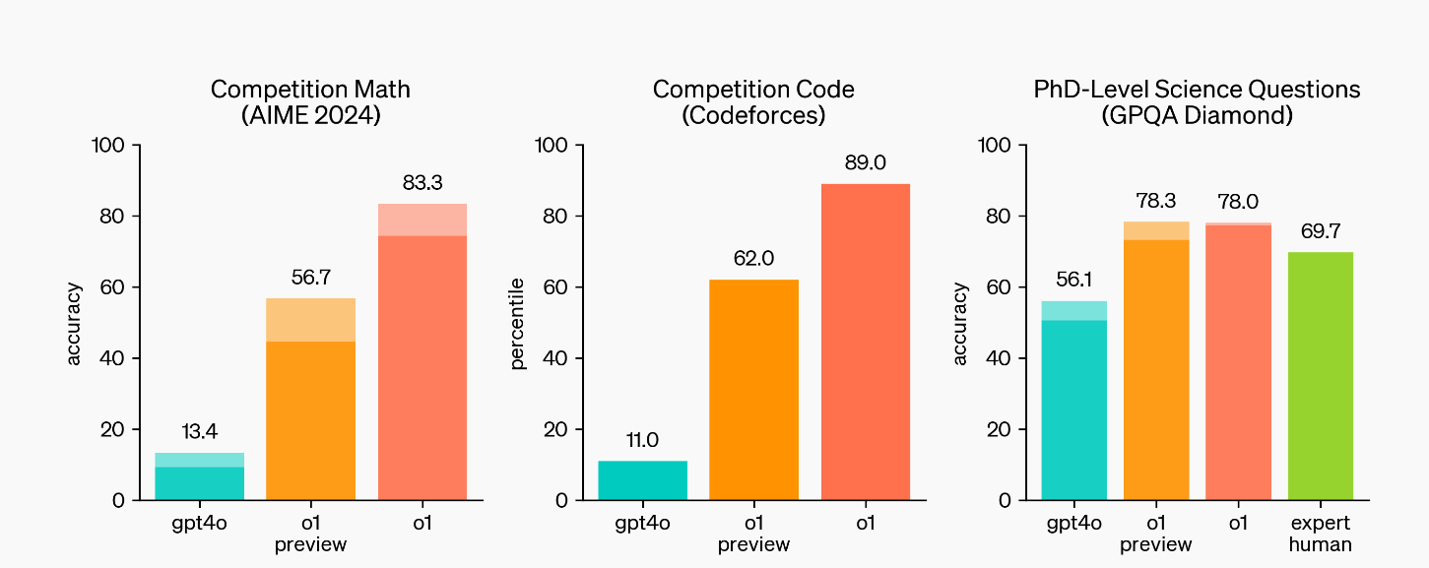
Logic and Reasoning: OpenAI o1 Benchmarks

Slide 10
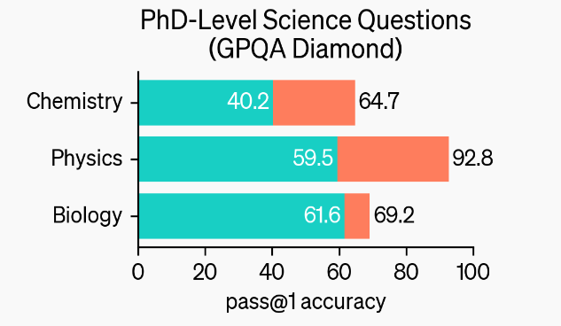
GPQA Diamond
https://openai.com/index/learning-to-reason-with-llms/

Slide 11
Astronomers are studying a star with a Teff of approximately 6000 K. They are interested in spectroscopically determining the surface gravity of the star using spectral lines (EW < 100 mA) of two chemical elements, El1 and El2. Given the atmospheric temperature of the star, El1 is mostly in the neutral phase, while El2 is mostly ionized. Which lines are the most sensitive to surface gravity for the astronomers to consider?
A) El2 I (neutral)
B) El1 II (singly ionized)
C) El2 II (singly ionized)
D) El1 I (neutral)
https://arxiv.org/pdf/2311.12022

Slide 12
Bulk Processing of Documents
Everything that can done in a ChatBot can be done repeatedly using Python
The programming isn’t terribly difficult, and there are examples.

Slide 13
Document Similarity
My student Ian Perry did an experiment to look at the similarity between AI summarized text and the human summaries of the same text.
100 Astrophysics papers on colliding galaxies were extract from ARXIV
The abstracts were separated from the main paper.
The AI created a summary of the main papers.
We did a comparison between the paper summaries by the AI and the original human created abstracts

Slide 14
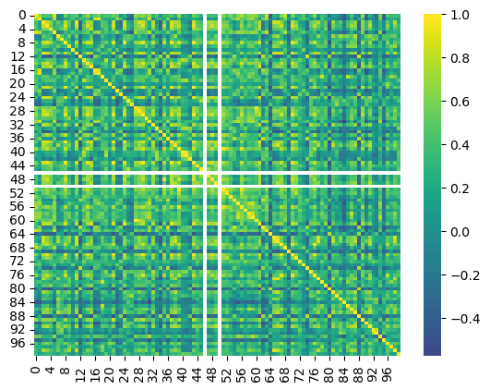
Similarity score between AI summaries and human abstracts
Human Abstract
AI generated Summary

Slide 15
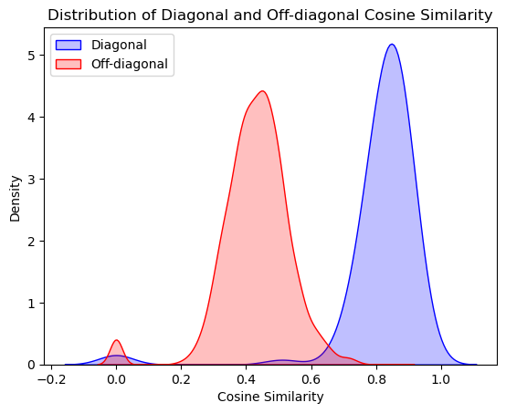
Similarites between actual matches and non-matches
Specificity = 0.97

Slide 16
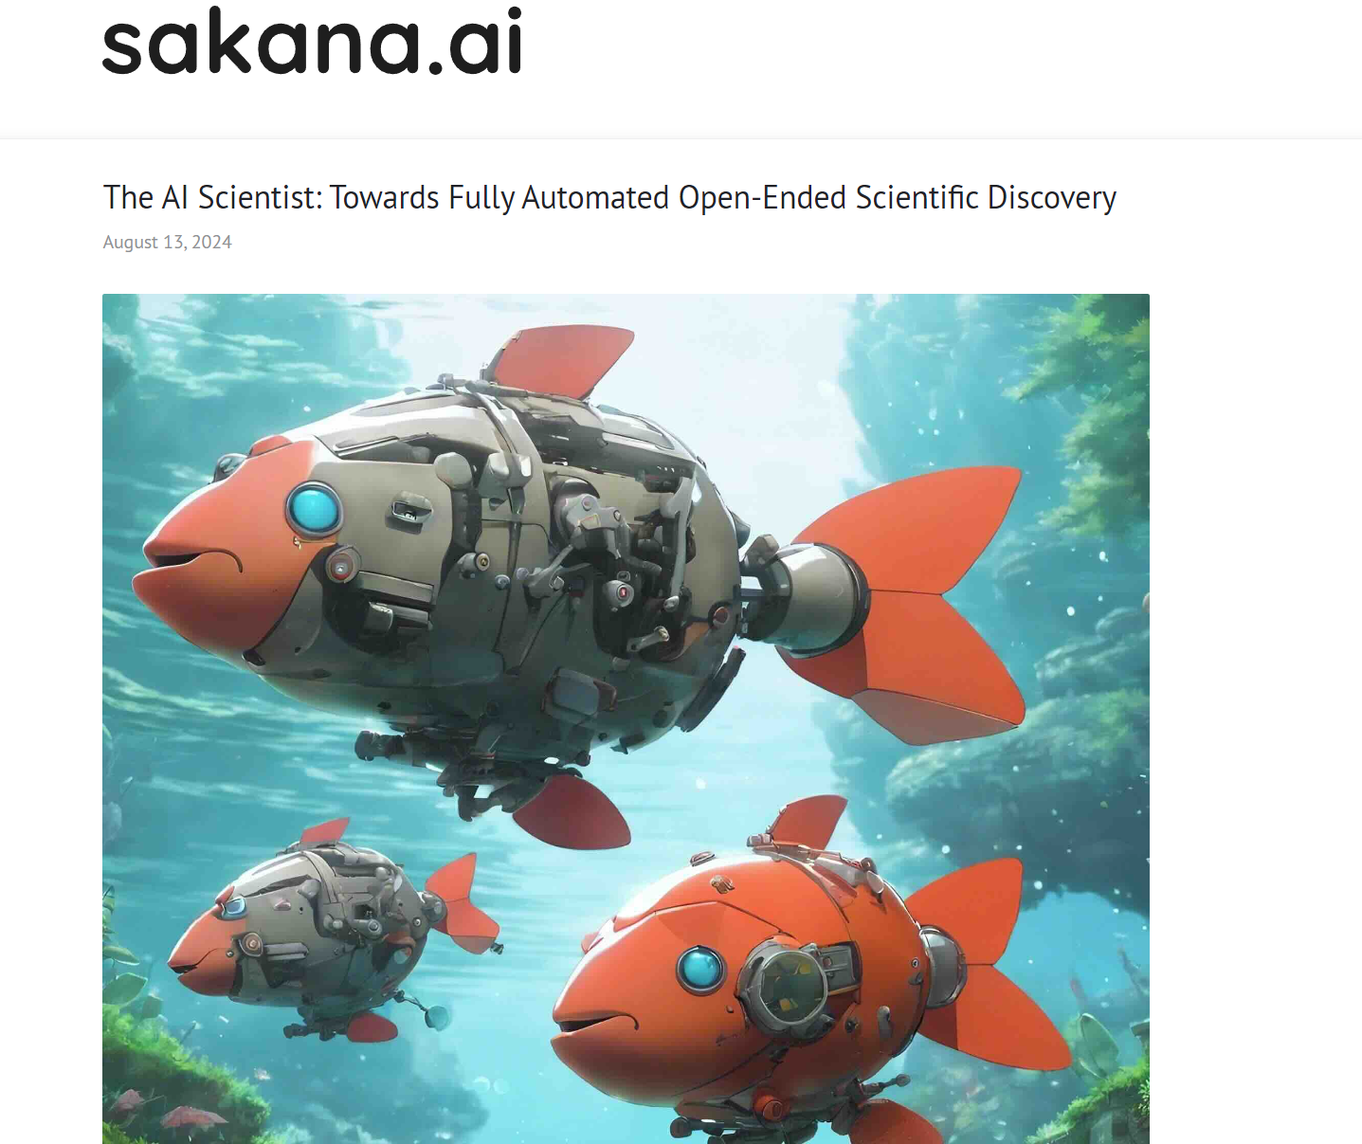
The AI Scientist

Slide 17
Generating Functions, Data, and Models
Generating Function – the underlying function that creates a data set. If we know this function, we have the perfect model of a system.
Data – Output from the generating function. This may involve random spacing in X values and noise.
Model – A functional form with optimized coefficients used to fit data. Ideally, this should reproduce the generating function.

Slide 18
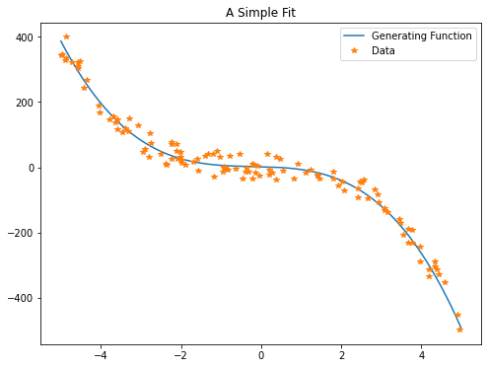
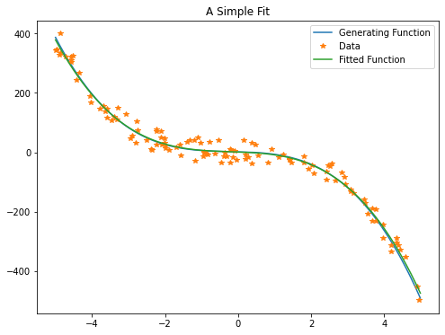
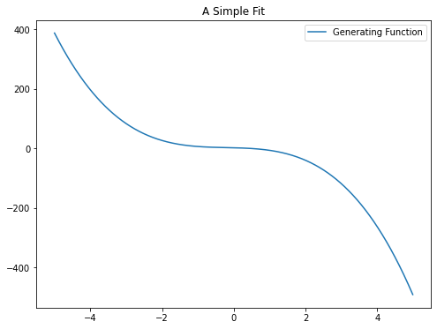
Cubic Generating Function and Cubic Model
DATA N=120
X Y
-2.9468 48.5658
4.9127 -451.7867
2.9092 -84.0606
-3.5901 117.2356
3.4592 -157.8959
-4.4253 244.3020
2.0622 -71.6911
0.4772 25.5488
-2.7738 105.4164
1.9182 -54.7380
…
generating function:
y = -2.600 x^0 + 4.400 x^1 - 4.600 x^2 - 0.100 x^3
fitted model:
y = -2.593 x^0 + 4.445 x^1 - 3.862 x^2 + 1.980 x^3

Slide 19
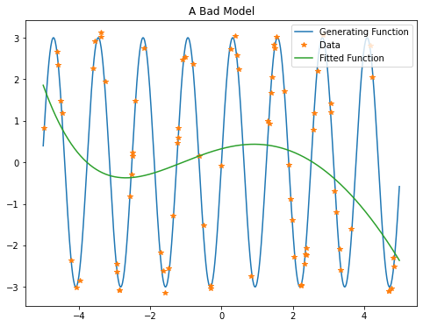
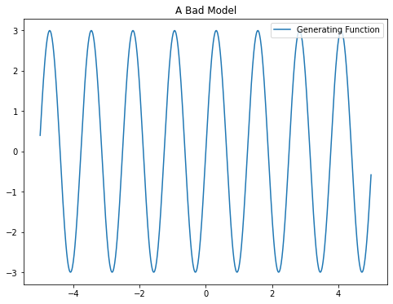
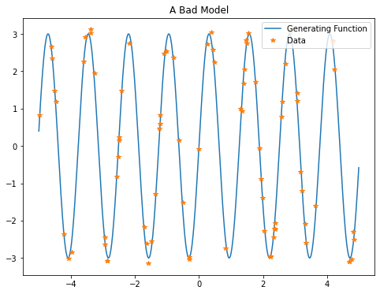
A Bad Model
generating function:
y = 3*sin(5*x)
X Y
2.5810 0.7884
-0.6294 0.1451
-0.3058 -2.9623
-4.4691 1.1832
2.3828 -2.0652
-1.2156 0.5980
3.1759 -0.7026
-3.3902 3.1167
1.7645 1.7206
-4.9827 0.8189
fitted model :
y = -0.000 x^0 + 0.003 x^1 - 0.022 x^2 - 0.097 x^3 + 0.224 x^4 + 0.326 x^5

Slide 20
A generalized model
If your model doesn’t match your generating function, you will never get a satisfactory fit.
Neural networks are a form of general model that can be applied to many situations successfully.
They tend to be applied on categorical data and classification, but regression is possible.
They are successful at many models where there is a large data set with complex inputs and a finite number of outputs

Slide 21
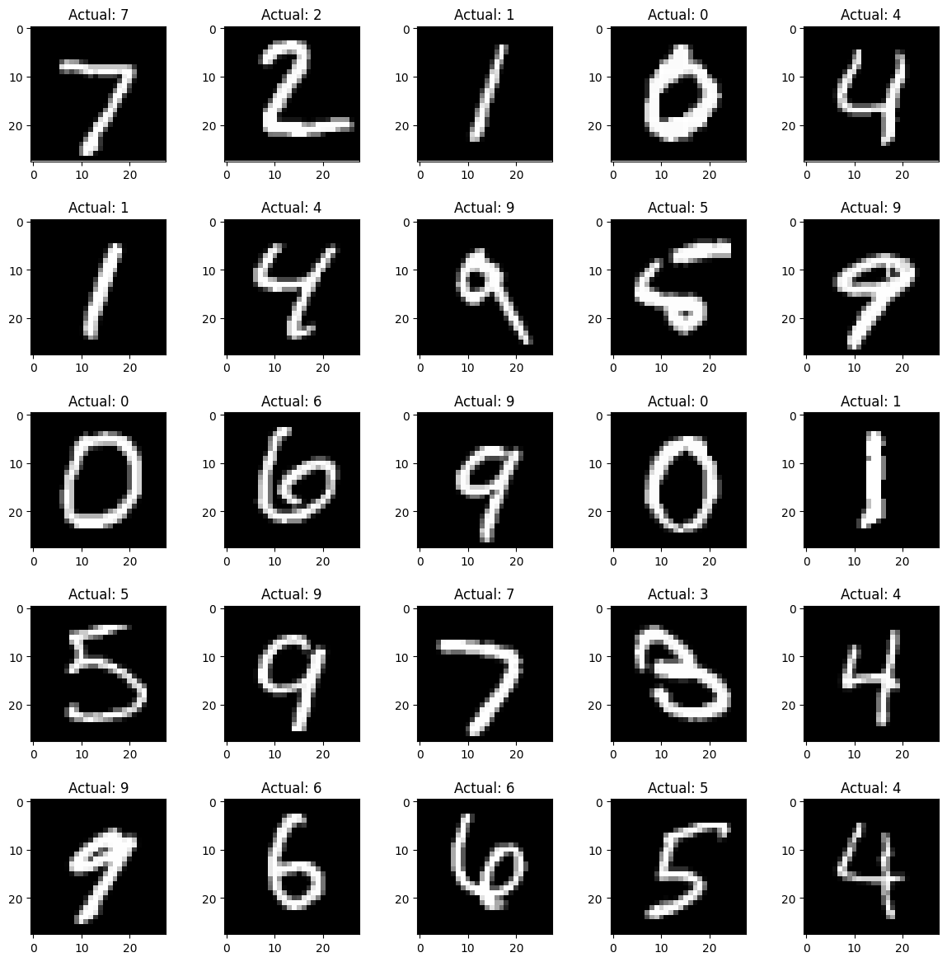
The MNIST Data Set
60,000 handwritten numbers
Expert classification for each image
Images are 28x28 pixels
Total data size = 3.36 Mb
1994 Data Set Created
2004 Error rate 0.42%
2011 Error rate 0.27%

Slide 22
Word2Vec an early example of embedding changing words into vectors
Word2Vec is a program created in 2013 by Tomas Mikolov and other at Google.
It uses to algorithm
“Continuous Bag of Words” – to predict the next word in a sentence
“Skip-Gram” – predicts words missing in a sentence give the context
Training is done using positive and negative examples to capture semantic and syntactic relationships

Slide 23
An Example of Word2Vect
The word “Apple” becomes: [ 0.64158976, -0.21014647, 0.588113 , ..., -0.40470958, 0.99179345, 0.76531297]
The word “Orange” becomes: [-0.08535365, -0.31420925, -0.09664118, ..., 0.5893312 , 0.44359636, 0.20136227]
These don’t look very similar – but if you measure the distance between them using a technique called “cosine similarity”, they are very close together compared to other words.

Slide 24
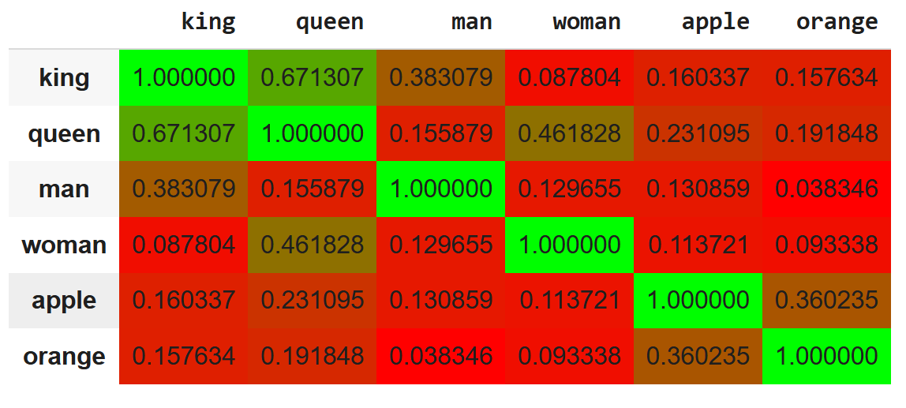
Cosine similarity table between some common words

Slide 25
Word Arithmetic
Result of 'president - country + company': ['company', 'ceo', 'corporation', 'president', 'executive’]
Result of 'king - man + woman': ['queen', 'elizabeth', 'princess', 'woman', 'her']

Slide 26
The Confusion Matrix
Is this a good result?

Slide 27
Somethings to know if you use ML
Confusion Matrix
Precision
Accuracy
Specificity
F1-Score
Model Loss
Model Accuracy
Suggested reading:
Deep Learning: A Visual Approach
by Andrew Glassner
(no starch press)
San Francisco 2021

Slide 28
Artificial General Intelligence
Artificial general intelligence (AGI) is a type of artificial intelligence (AI) that matches or surpasses human capabilities across a wide range of cognitive tasks. This is in contrast to narrow AI, which is designed for specific tasks. AGI is considered one of various definitions of strong AI. (https://en.wikipedia.org/wiki/Artificial_general_intelligence)

Slide 29
Large Language Model Data Sets and Weights
Simple Code
https://github.com/nshepperd/gpt-2/tree/finetuning/src
Huge data sets
GPT-1 (2018) 7000 unpublished books
GPT-2 (2019) 40 gigabytes
GPT-3 (2020) 570 gigabyte
GPT-4 (2023) 45 Terabytes
GPT-4o (2024) 45 Terabytes
Complex networks based on Transformers
GPT-1 117 million weights
GPT-2 1.5 billion weights
GPT-3 175 billion weights
GPT-4 1.6 trillion weights
GPT-5 5 trillion weights????
The human brain has approximately 1000 Trillion synapses and 86 billion neurons

Slide 30
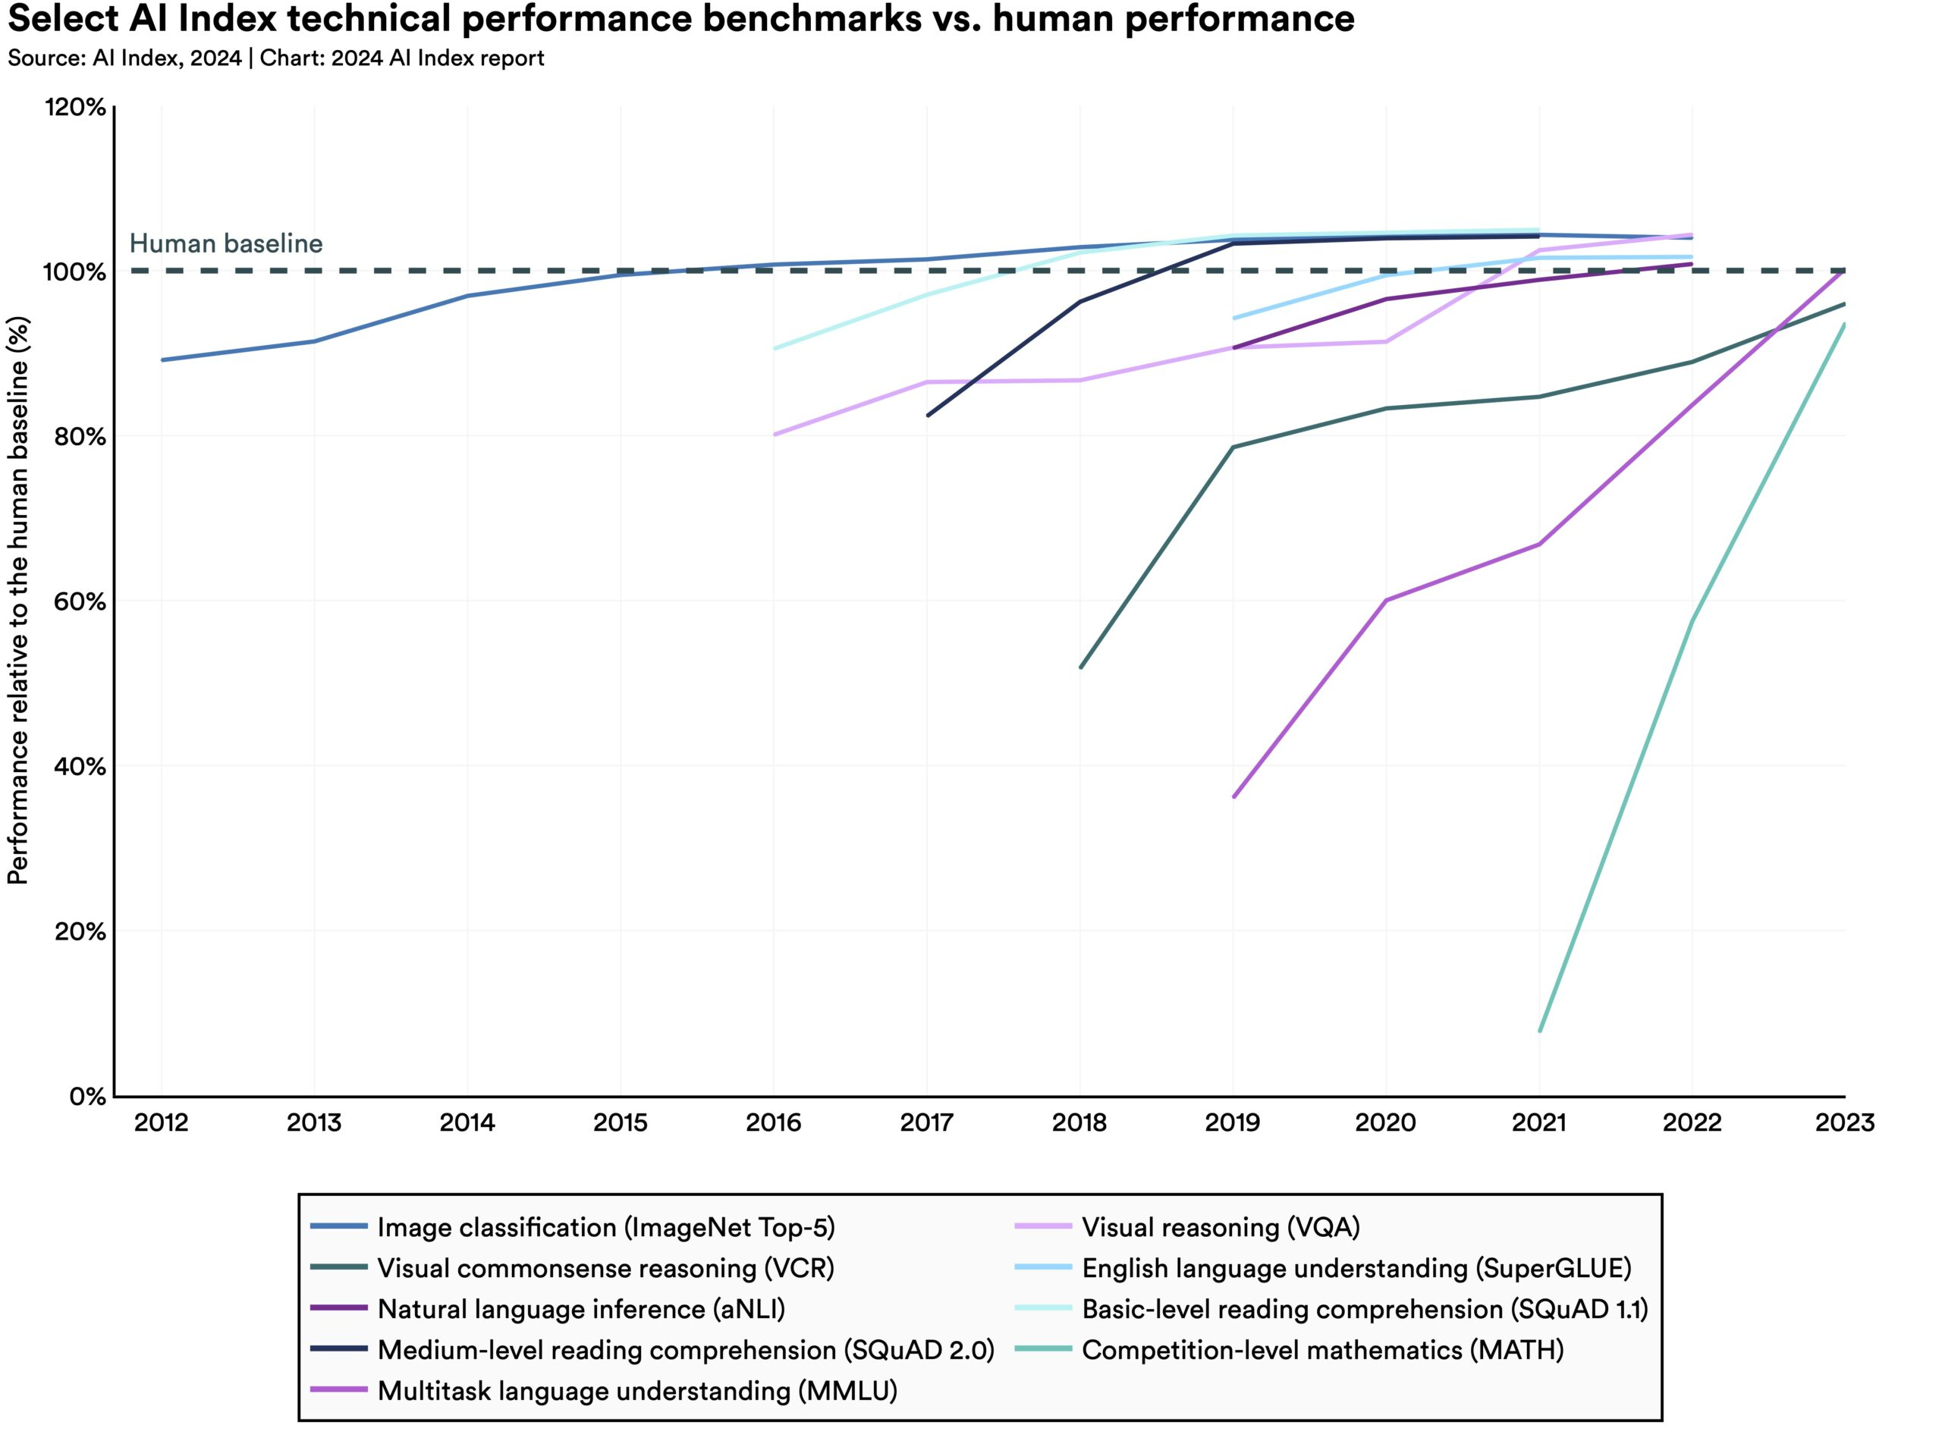
How fast is AI getting better?
https://aiindex.stanford.edu/report/

Slide 31
Some thoughts on Ethics
Transparency: Researchers should be required to disclose the AI contributions in their intellectual output so the university can evaluate the faculty’s impact in research. This is a standard requirement for most journals now, but it may not appear in the paper itself. Requiring researchers to note the level of the AI contributions to their work in their annual reports and tenure packet matters during evaluation. (Probably something like models, typical prompts, and level of impact on the work would be appropriate.)
Responsibility: The researcher must assume all responsibilities for the accuracy and integrity of the work the AI produces. This would include the accuracy of the results, plagiarism, biases, etc. These things will produce garbage, and the faculty can’t use the excuse “the AI did it” to avoid ultimate responsibility.
Data integrity: There is a danger with any AI system of the user’s data being included in the training sets. This has profound implications for IRB data. We should consider 1) getting a campus solution (Enterprise OpenAI, for example) that doesn’t include our prompts in the training set and/or 2) setting strong limits about what kind of data can be put into AI systems.

Slide 32
Bloom’s Hierarchy of Knowledge
Definition
Comparison
Analysis
Synthesis
Evaluation

Slide 33
Scholarship
We seem to be moving toward an intellectual system that emphasizes review of ideas instead of generation of knowledge.
We gained our ability to evaluate ideas through years of study. Most of this study was spent at the lower level’s of Bloom’s Hierarchy.
How do we instill the ability to evaluate without this foundation?
How do we evaluate an idea when we don’t have the cognitive basis for understanding how it was obtained?

